Slide 1
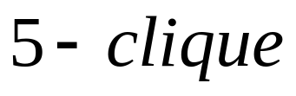
Clique Problem
Given undirected graph G, a clique is a set of nodes of G such that every two nodes are connected by an edge.
A k-clique is a clique with k nodes
NP-Completeness
1

Slide 2

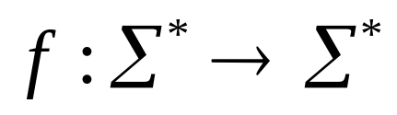
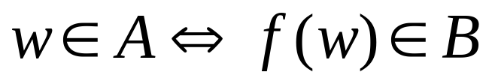


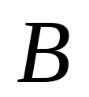
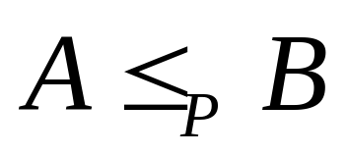
Polynomial Time Reduction
Assume that A and B are two languages on
A is polynomial time mapping reducible to A if a polynomial time computable function exists such that
NP-Completeness

Slide 3

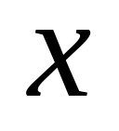
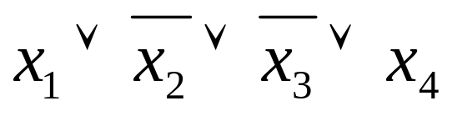
Boolean Formula
A literal is either a boolean variable or its negation:
A clause is the disjunction of several literals
Conjunctive normal form is the conjunction of several clauses
NP-Completeness

Slide 4
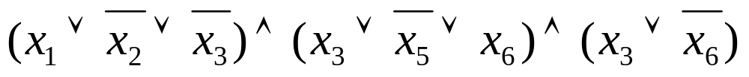

SAT
A conjunctive normal formula is a conjunction of several clauses
SAT={ | is satisfiable conjunctive normal formula}
NP-Completeness

Slide 5






SAT to CLIQUE
Example:
NP-Completeness

Slide 6
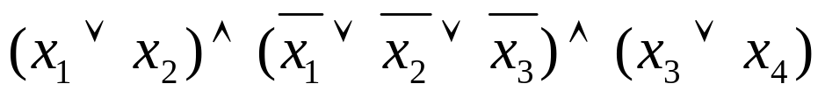
Problem
Given the formula f=
construct a graph G such that f is satisfiable iff G has a clique of size 3.
NP-Completeness

